Slide 1

Partial Revision of DENAN Appendix 8 and Interpretation of DENAN Scope (Safety measures for electric sterilizers with germicidal lamp)
Electric sterilizers with germicidal lamps that emit the light of the germicidal lamp toward outside of the main unit are rapidly becoming popular. Therefore requirements to ensure the safety of electric sterilizers have been added to the technical standard. At the same time, it is clarified that the electric sterilizers that irradiates the light toward outside of the main unit is subject to the DENAN regulation.
1. Background of this revision
● The current DENAN technical standard covers the structure of ①. Recently, the structure of emitting light of germicidal lamp toward outside of the main unit, such as ② and ③ are rapidly becoming popular.
● Since germicidal lamps emit ultraviolet rays that damage the eyes and skin, requirements necessary for safety were added to the interpretation of technical standards for electric sterilizers with a structure that directly irradiates light toward outside the main unit.
2. Overview of this revision
● Added the following requirements for those that directly irradiate the outside of the main unit to the section of Appendix 8-2 (21) electric sterilizers.
a. Exempted group from the risk of "ultraviolet radiation injury to eyes and skin" according to JIS C 7550.
b. The warnings specified in Clause 9.1 of JIS C 7605 (sterilization lamp) are displayed in a method that is easy to see on the body, does not disappear easily, and is easy to understand.
● In the interpretation of DENAN scope, it is added that "electric sterilizer" means a device that incorporates a germicidal lamp and is used for disinfection by irradiating rays of the germicidal lamp inside and outside the device.
3. Effective date of this revision
Effective date: December 28, 2021 (1 year transition period until December 27, 2022)
①
②
③

Slide 2
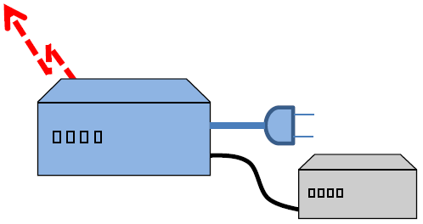
Partial Revision of DENAN Appendix 10 (Revision of noise requirements for LED lamp)
DENAN Appendix 10 defines the limit of emission for DENAN products, but no requirements for electromagnetic interference from luminaries. Since countermeasures against communication disturbance caused by radio noise emitted from the lamp are not sufficiently taken, the requirements were reviewed and revised to comply with CISPR standard.
1. Background of this revision
〇 DENAN Appendix 10 (Japanese original requirements) and Appendix 12 (Harmonized standards) specify the limits of emission.
〇 Many of the limits in Appendix 10 were established in May 1987. And they did not sufficiently cover new products and technologies afterwards.
〇 For example, for luminaries, the limits in Appendix 10 include disturbance power, but don’t include radiated emission. Therefore there is a risk of insufficient countermeasures against communication failures caused by radio noise emitted from LED lamps of luminaries.
2. Overview of this revision
The requirements for noises of LED lamp in Appendix 10 are replaced by the requirements of J55015 in Appendix 12.
3. Effective date of this revision
Effective date: December 28, 2021 (1 year transition period until December 27, 2022)
Noise generated inside the equipment is directly radiated using the enclosure and other parts of the equipment as antennas and becomes an interference wave.
Radiated emission
Disturbance power
Noise transmitted through power and signal lines cause interference to other devices.

